Slide 1


KABAM DATA SCIENCE A CASE STUDY
YOGESH PADMANABAN
Notes:
Welcome One and All. I am Yogesh Padmanaban. Today, I am going to present a data science case study on Kabam Gaming data on the game of Kingdoms of Camelot.

Slide 2
Why DATA SCIENCE?
Data Science is the art and science of knowledge extraction from data.
Given the Data,
What does it mean/imply to have these observations?
What are the Patterns and anomalies hidden in the data.
What stories does it tell ? The ecosystem behind the data.
What should we expect in the future from the data.
Notes:
Why do we perform Data Science on the Huge data presented to us.
Data Science is the science
Given the Data in front of us. We want to understand what does it mean to have these observations. Time series decomposition / Time series prediction.
Patterns: Regression. Anamolies: Fraud detection.
What are the factors which governed these observations. What are the defining components of the Ecosystem. The raw dependencies between the data.
Future Predictions: Predict data following a mathematical model.
What are the

Slide 3
DATA SET
Attacks Data.
Alliance Chat.
User Data.
Date: 2013/10/25 to 2013/12/18
Notes:
The Given Data for this Data Science study: 1. Attacks data. 2. Alliance Chat. 3. User Data. The data consists of two months worth of data.
1.Attacks data consists of details of the matches.

Slide 4
Agenda
Measuring User Performance
Classification of Users as Spenders and Non Spenders.
Relationships between User Expenditure Vs Performance & Social Interaction.
Text Processing of Alliance Chats.
User Choices of Alliances, Knights and Geo Politics.
Location Vs User Performance.
IDEAS
Notes:
The following is today’s Agenda.
Measure a User’s Performance.
Classify a Users as Spender or a Non Spender based on his activities.
Relationship between Expenditure and Performance / Social Interaction.
Text Processing of Alliance Chats.
User’s Choices of Alliances,Knights and Geo Politics.
Location vs Performance.
IDEAS

Slide 5
I.MEASURE User PERFORMANCE
PURPOSE:
Gauge User proficiency and Alliance proficiency.
Help the poor performers. ( Boosts, Training, Easy Mode)
Challenge the Strong ones. ( Medals, Challenging Rounds, Tough Modes ).
Establish the Leaderboard for Users/Alliances/Knights.
Notes:
Purpose is that segregate the users into strong users and ones who need help .

Slide 6

I.MEASURE User PERFORMANCE
PROCEDURE: User Performance is computed for each match.
It is then averaged across matches. It is defined by the following scores.
Defense Score
Attack Score
Knight Attack Score
Knight Defense Score
Winning Count
Losing Count
Draw Count
$User Performance = Wincount –LostCount + 0.5×DrawCount +$ $DefenceScore+$
$AttackScore + KnightAttackScore+ KnightDefenceScore$
Notes:
The User Performance is measured on every match for both defender and attacker.
The following are the steps to arrive at the User Score.
a.Defense Score b.Attack Score. C.Winning Count D.Lost Count E.Draw Count. F.Knight Attack Score G.Knight Defense Score.
The formula computes the performance of the user.

Slide 7

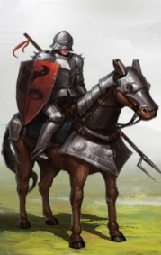









I. MEASURE User PERFORMANCE
MIGHT SCORE:
$$Defender S0Might=\sum^{Army Size}{Might of the Defense Troop ×\# of members }$$
$$Defender S0MightLost=\sum^{Army Size }{Might of the Defense Troop died×\# of members died }$$
LOOT SCORE:
$$LOOTSCORE=LOOTGOLD×10+LOOTFOOD×5+LOOTWOOD×3+LOOTORE×2+LOOTSTONE$$
Notes:
Might Score is the summation of value of the troop and the number of troops they have in the army.
Might lost is the number of troops they lost in the battle multiplied by the number of troops.
Loot score is the measurement of the looted resources from the defense side by the attackers.
Arbitrarily gold gets 10X value, 5X value for Food, 3x value for wood, 2x value for ore and Stone.

Slide 8

I.MEASURE User PERFORMANCE
DEFENSE SCORE: It is a comprehensive score measuring User’s defending capabilities. It is defined by the following:
Ratio Of Wall strength to Rounds fought (+).
S0Might of Defending User (+).
S0MightLost by Defending User (-15%).
S1MightLost of Attacking Enemy (+).
S1Boosts taken by Attacking Enemy ( +10% ).
S0Boost taken by Defending User (-1%).
Enemy’s Combat level (+ 10%).
Defending User's Combat level (+).
Enemy’s Loot Score(-15%).
$$DefenseScore=log\left\{\begin{aligned} \left( \frac{Wall}{Rounds}\right)+S0Might−\left(S0Boost\right)×0.01−0.15×\left(S0MightLost+LootScore\right) \\ +0.1×\left(S1Boost+ S1CombatLevel \right)+ S1MightLost +S0CombatLevel\end{aligned}\right\}$$
Notes:
We have the following fields in the defense Score.
Ratio of the Wall strength/Rounds measures the tenacity of the Wall.
S0Might , MightLost , Boosts taken, Combat Level , Loot Score.
This comprehensively represents the defense strength of the User.
15 % of score is reduced for the might lost on your side.
10% of your score improved based on the boosts taken by the enemies.
1% penalty if you take boosts.

Slide 9

I.MEASURE User PERFORMANCE
ATTACK SCORE: It is a comprehensive score measuring User’s attacking capabilities. It is defined by the following:
Ratio Of Wall strength to Rounds fought (-).
S1Might of Attacking User (+).
S1MightLost by Attacking User (-15%).
S0MightLost of Defending Enemy (+).
S0Boosts taken by Defending Enemy ( +10% ).
S1Boost taken by Attacking User (-1%).
Enemy’s Combat level (+ 10%).
Defending User's Combat level (+).
Loot Score(+).
Experience (+).
$$AttackScore=log\left\{\begin{aligned}S1Might− \left( \frac{Wall}{Rounds}\right)+LootScore−\left(S1Boost\right)×0.01−0.15×\left(S1MightLost\right) \\ +0.1×\left(S0Boost+ S0CombatLevel \right)+ S0MightLost +S1CombatLevel+XP\end{aligned}\right\}$$
Notes:
The Given Data for this Data Science study: 1. Attacks data. 2. Alliance Chat. 3. User Data.

Slide 10
I.MEASURE User PERFORMANCE
Best Performing Users
Userid | Defense Score | Attack Score | Win Count | Lost Count | Draw Count | User Performance
100218 | 326.8772 | 4955.199 | 17688 | 151 | 150 | 23271.08
6344024 | 1278.306 | 12549.81 | 7518 | 75 | 155 | 21576.12
3765281 | 3674.813 | 4366.809 | 12027 | 257 | 1026 | 21351.62
2. Best Defending Users
Userid | Defense Score | Attack Score | WinCount | LostCount | DrawCount | User Performance
1492912 | 15060.61 | -4192.5 | 1391 | 92 | 1896 | 14247.11
25609 | 10325.44 | 1959.227 | 1046 | 335 | 102 | 13767.67
9114900 | 8671.873 | 0 | 0 | 0 | 4226 | 12897.87
Stationary Defenders?
Notes:
Among the “best category” for various performances, we have different tables. I have show cased only a sample here. The Documents gives better view on them. WE are now going to look at the concept of.

Slide 11
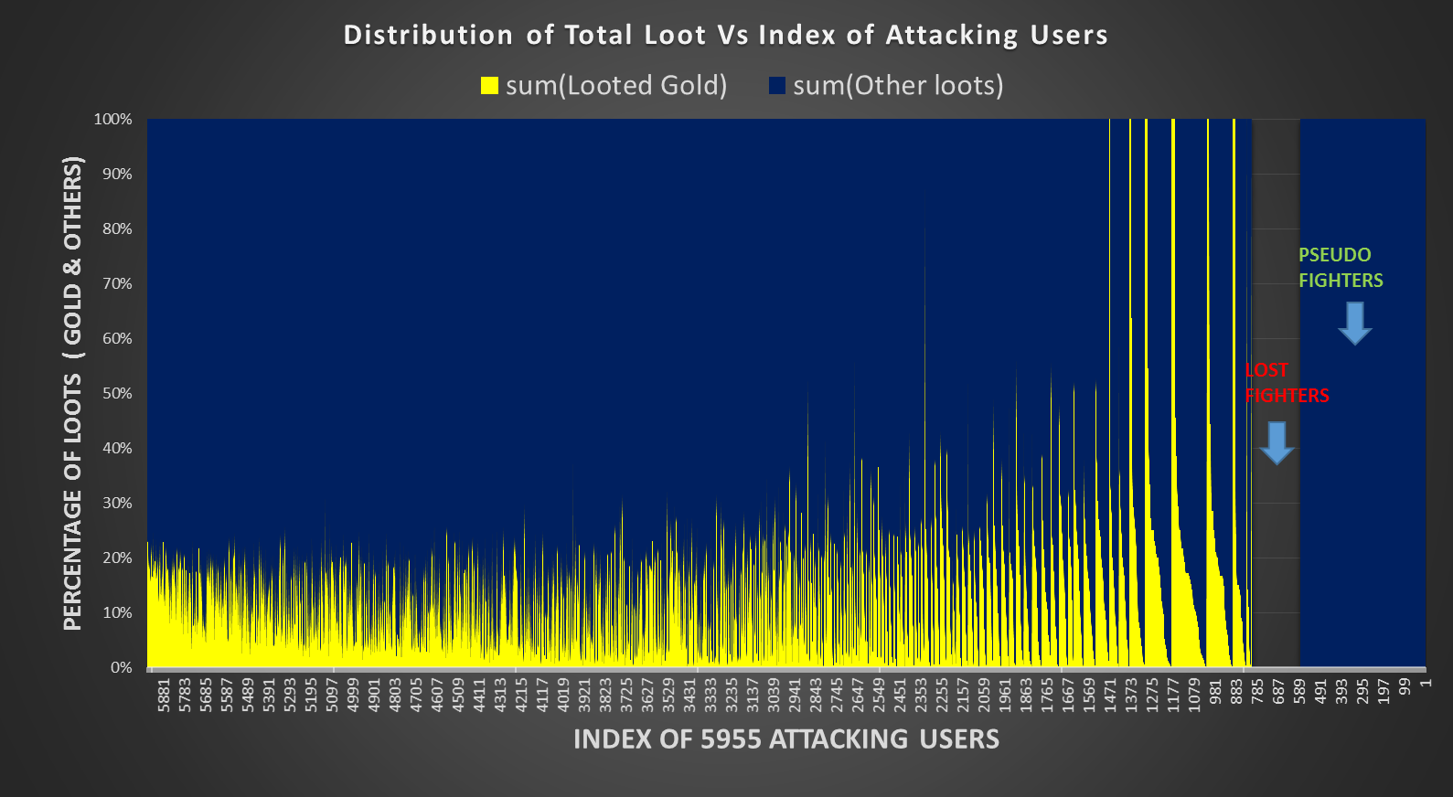
I.MEASURE User PERFORMANCE
PSEUDO WARRIORS They wage wars with an intent of only collecting resources.
GOLD
SEEKERS
Notes:
1.This is a graph about Attackers and the percentage of their looted resources.
2. Three segments of attckers.
1.Gold Seekers : they only seek gold.
2. The lost attackers. They never won any match.
3.Third is the Pseudo who only look for resources when fighting a match.
4. Fourth is the warriors who were able to take gold as well as other resources.

Slide 12
II. CLASSIFICATION OF Users (SPENDERS OR NOT)
SUPERVISED LEARNING:
Training Set: Set of m input data, X (set of Independent variables) and its Output data, Y (Dependent variable).
Hypothesis/Classifier H: A mapping function between the Input and the Output.
Learning Algorithm: The Algorithm by which we obtain the hypothesis H to map the input to Output.
Continuous Output: Regression Problem.
Discrete Output: Classification Problem.
Notes:
Classify the users into Spenders and Non Spenders.
We use the supervised learning technique to obtain the users the who spend money vs the ones who don’t.
Supervised learning works as follows.
Training set is a set of all input output combinations.
Hypothesis is a mapping function which maps the input to the output.
Learning Algorithm: the algorithm which we use to train the classifier using the training data is the learning algorithm.
If the output is continuous we wil get a regression problem.
If the output is discrete we will have the classification problem.

Slide 13
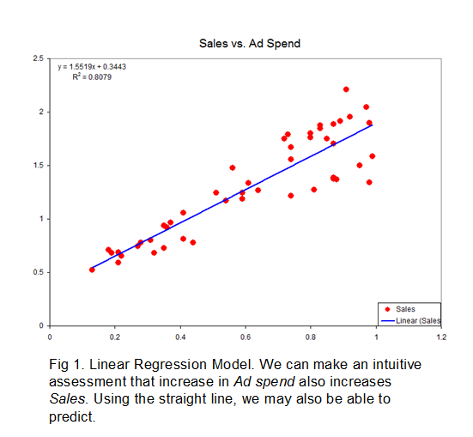

II. CLASSIFICATION OF Users (SPENDERS OR NOT)
LINEAR REGRESSION
The hypothesis is a linear function of input X.
Training set consists of $m$ pairs of $X$ and $Y$.
$X$ , a set of independent variables. $X= \left\{x_{1}{,x}_{2}, …{,x}_{n}\right\}$
$Y$ , a continuous dependent variable. $Y=\{y\}$
$Hypothesis,$ $h_{θ}\left(x\right)= \sum_{i=0}^{n}{θ_{i}x_{i}}= Θ^{T}X$
$θ_{i}$ ’s : weights updated using training set till convergence.
Cost : squared error between $Y$ and $h_{θ}\left(x\right)$.
Notes:
Given the set of input data. And the corresponding output data.
We want to map the input to the output.
Be default .. Express output as a linear function of input. A X + B
Define A and B from the input Data.
3. Draw a line which passes through the points as much as possible.
4. Modify A and B so as to reduce the distance between data and the line.
Consider Output being a discrete 0 or 1. Sigmoid S shaped curve.

Slide 14
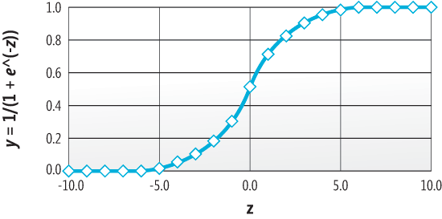
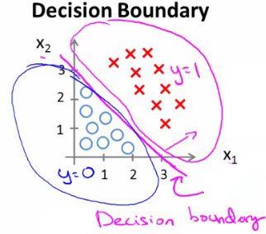

II. CLASSIFICATION OF Users (SPENDERS OR NOT)
LOGISTIC REGRESSION
For a binary output variable, $Y=\{0,1\}$we use sigmoid function $g\left(z\right)= \frac{1}{1+e^{−z}}$ to smoothly transition between 0 and 1.
The log likelihood of the outcome $Y$is modeled as a linear combination of the input $X$.
$Logistic Hypothesis ,h_{θ}\left(x\right)=\frac{1}{1+e^{−Θ^{T}X}}$
$p\left(y=1 | X;θ\right)=h_{θ}\left(x\right) ;$
$p\left(y=0 | X;θ\right)=1−h_{θ}\left(x\right)$
$p\left(y | x;θ\right)= {\left(h_{θ}\left(x\right)\right)}^{y}∗{\left(1 −h_{θ}\left(x\right)\right)}^{1−y}$
$Likelihood=$ $P\left(Y | X;θ\right)= \prod_{i=1}^{m}{p(y^{(i)}│x^{(i)};θ)}$
$Cost: Log (Likelihood)$
Notes:
The Given Data for this Data Science study: 1. Attacks data. 2. Alliance Chat. 3. User Data.

Slide 15
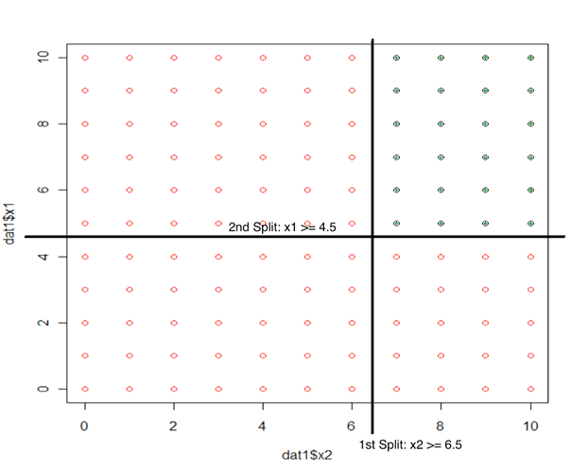
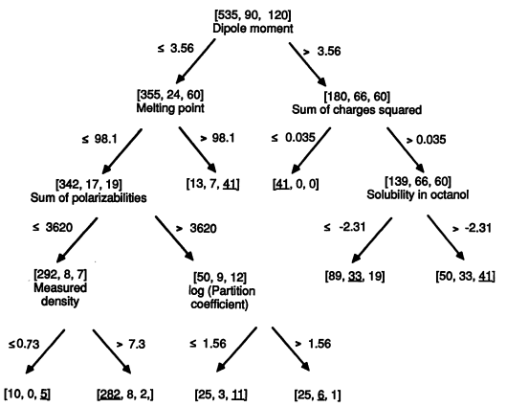

II. CLASSIFICATION OF Users (SPENDERS OR NOT)
DECISION TREES
Classification tree models recursively partition the data space one variable at a time.
Choosing the next variable to split the data is based on Information measures entropy for Recursive Partition ($rpart$) Trees in $R.$
They Fit a simple prediction within each of the rectangular partitions.
Assumption: decision boundaries are parallel to axes.
Notes:
Consider a Vanilla cake with choclate pieces of box in it.
We need to separate them into choclate or vanilla.
We have three coordinates length, breadth and height of the cake.

Slide 16
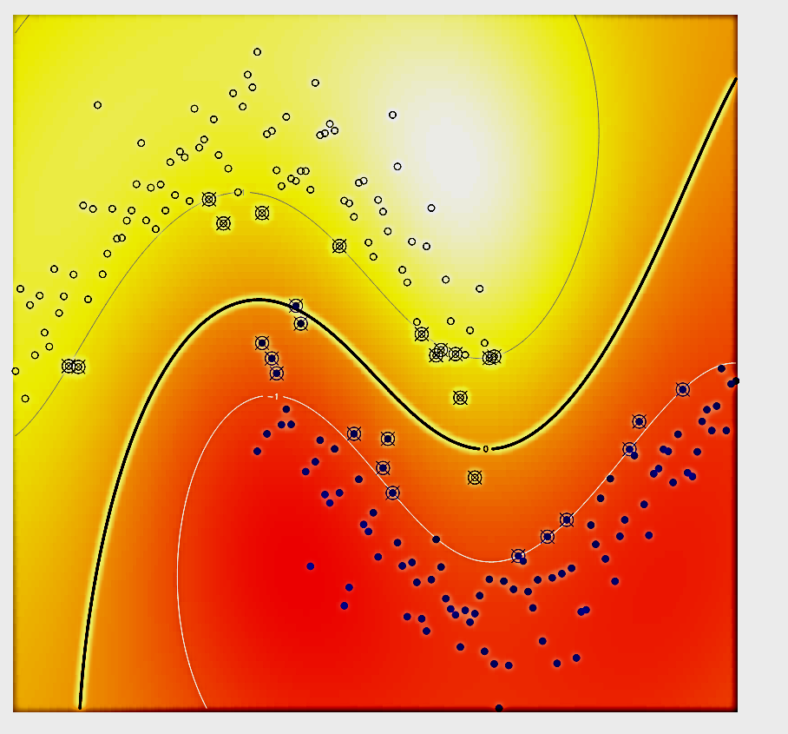
II. CLASSIFICATION OF Users (SPENDERS OR NOT)
Support Vector Machines
They separate the data using a (Hyperplane) with maximum Margin.
Margin is the closest distance between data points & decision surface.
The decision surface is specified by a subset of the data, the Support Vectors.
They use Kernels to map the data into higher dimension to make it linearly separable.
DATA POINTS
Support Vectors
DECISION SURFACE
Notes:
The Given Data for this Data Science study: 1. Attacks data. 2. Alliance Chat. 3. User Data.

Slide 17

II. CLASSIFICATION OF Users (SPENDERS OR NOT)
Support Vector Machines kernels
Notes:
The Given Data for this Data Science study: 1. Attacks data. 2. Alliance Chat. 3. User Data.

Slide 18
II. CLASSIFICATION OF Users (SPENDERS OR NOT)
FEATURES SET
User Performance : User scores, Match Results, Alliance association, match frequencies.
Alliance Performance : Alliance Scores, Match results.
Knight Performance : Knight Scores, Match results, match frequencies.
User Social : User Sentiments, User subjectivity, chat counts.
User Delight : Loots, Boosts, Mights, Wall Strengths & XPs.
TRAINING DATA: Feature Set of 4000 Users from total of 5387 User data.
TEST DATA: Feature Set of 1387 User Data.
Number of Features: ~44
Notes:
The Given Data for this Data Science study: 1. Attacks data. 2. Alliance Chat. 3. User Data.

Slide 19
II. CLASSIFICATION OF Users (SPENDERS OR NOT)
FEATURES SET
User Performance : User scores, Match Results, Alliance association, match frequencies.
Alliance Performance : Alliance Scores, Match results.
Knight Performance : Knight Scores, Match results, match frequencies.
User Social : User Sentiments, User subjectivity, chat counts.
User Delight : Loots, Boosts, Mights, Wall Strengths & XPs.
TRAINING DATA: Feature Set of 4000 Users from total of 5387 User data.
TEST DATA: Feature Set of 1387 User Data.
Number of Features: ~44
Notes:
The Given Data for this Data Science study: 1. Attacks data. 2. Alliance Chat. 3. User Data.

Slide 20
II. CLASSIFICATION OF Users (SPENDERS OR NOT)
Metrics Of Evaluation:
Precision: Ratio of correctly classified positives to number of items classified as “positive”.
Recall or True Positive rate: Ratio of correctly classified positives to total number of positives.
Accuracy: Ratio of correctly classified items(+ve and –ve) to the total number of items.
Specificity: Ratio of correctly classified negatives to total number of negatives.
Fall Out or False Positive rate or : Ratio of correctly classified negatives to number of items classified as “negative”.
Mutual Info: Amount of information shared between the test truth & test predictions.
F1 Score: Weighted average of Precision and Recall.
Area Under the ROC Curve: Area of region under the curve between Recall and Fall Out.
Notes:
Precision is the ratio of the correctly classified positive items to the items classified as ‘positive’
Recall, ratio of correctly classified positive items to the actual number of positive items.
Accuracy.. Total correctly classified positive and negative to the total number of elements.
Specificity is the ratio of correctly classified negative items to the total negative items.
Fall out or fpr is the ratio of correctly classified neg items to the items classified as negatives.
Mutual Info is the info share between the test truth and test prediction.
F1 scoreL weighted avg of precision and recall.
AUC: it is the area under the curve. Between true positive rate and false positive rate.

Slide 21
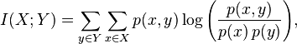
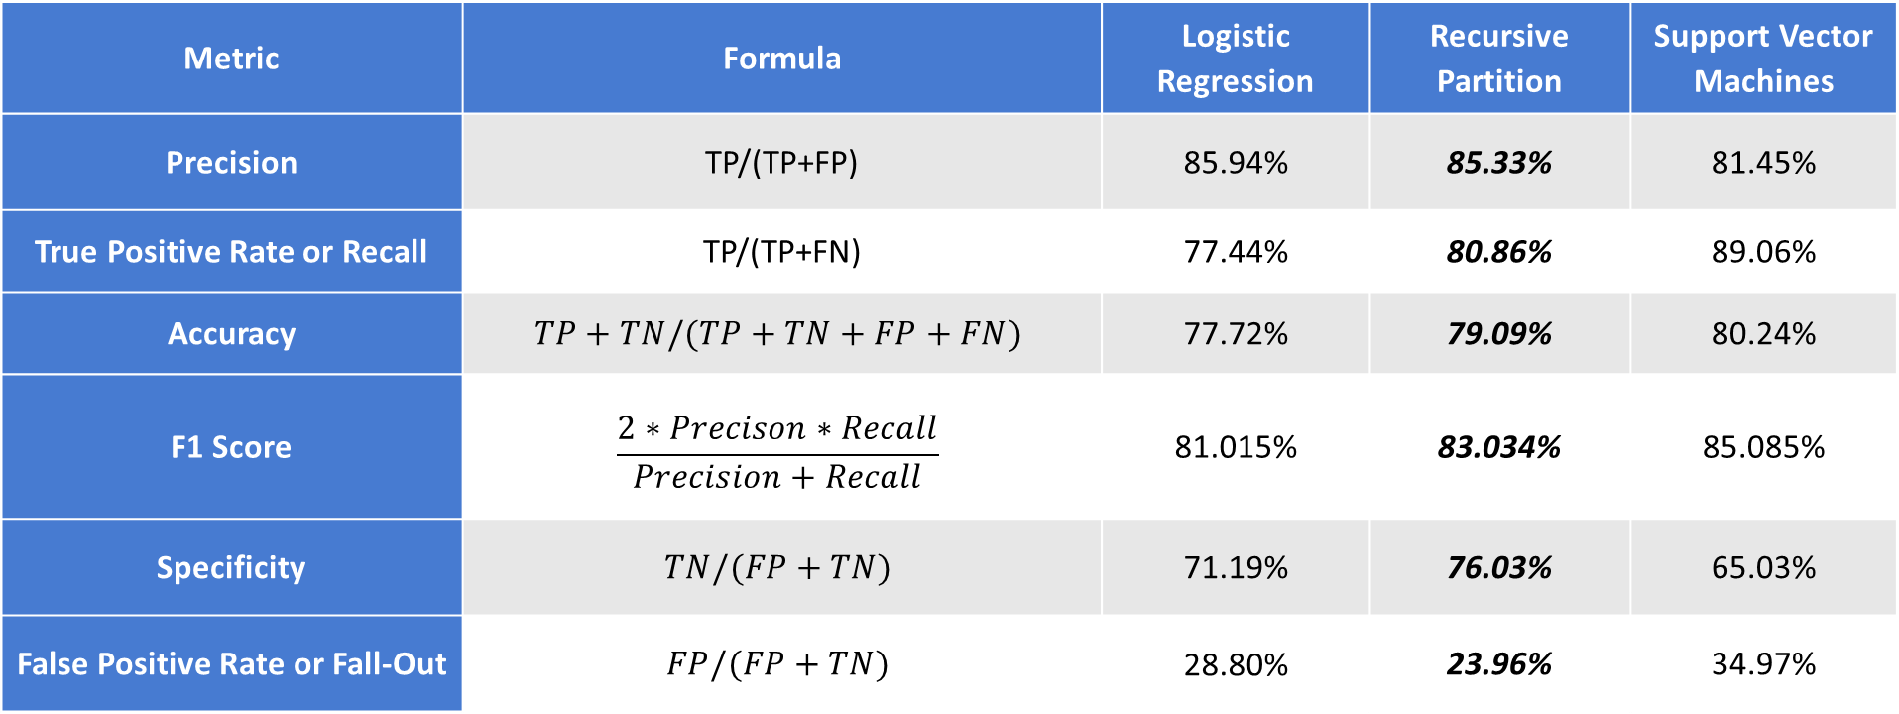
II. CLASSIFICATION OF Users (SPENDERS OR NOT)
RESULTS
Metric | Formula | Logistic Regression | Recursive Partition | Support Vector Machines
Precision | TP/(TP+FP) | 85.94% | 85.33% | 81.45%
True Positive Rate or Recall | TP/(TP+FN) | 77.44% | 80.86% | 89.06%
Accuracy | $$TP+TN/(TP+TN+FP+FN)$$ | 77.72% | 79.09% | 80.24%
F1 Score | $$\frac{2∗Precison∗Recall}{Precision+Recall}$$ | 81.015% | 83.034% | 85.085%
Specificity | $$TN/(FP+TN)$$ | 71.19% | 76.03% | 65.03%
False Positive Rate or Fall-Out | $$FP/(FP+TN)$$ | 28.80% | 23.96% | 34.97%
Notes:
The following are the values of the metrics obtained for the classifiers built to divide the users into spenders or non spenders.
Here the choice is based on precision, recall ,specificity and

Slide 22
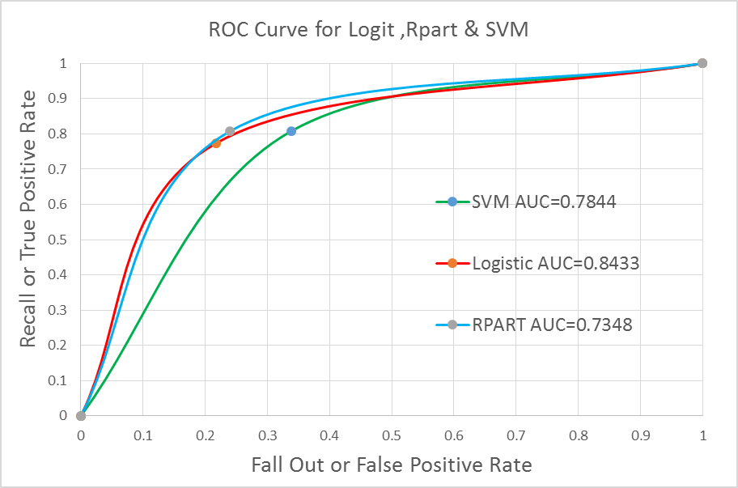
II. CLASSIFICATION OF Users (SPENDERS OR NOT)
RESULTS
Metric | Formula | Logistic Regression | Recursive Partition | Support Vector Machines
Mutual Information (Test Prediction , Test truth) |  | 0.1528 | 0.1619 | 0.1113
Area Under the Curve | Area under the ROC curve | 0.8433 | 0.7844 | 0.7347
Notes:
Given below is an ROC curve which shows how the true positive rate increases with minimum increase in the false positive rate before the threshold. After the threshold they both start increasing. The peak productivity is obtained at the threshold.

Slide 23
III. EXPENDITURE vs PERFORMANCE & SOCIAL INTERACTION
AIM
To study the Performances and Social Interaction of high spending users in the Game of Kingdom of Camelot.
PURPOSE
The Gamers who spend money on games are our VIP customers.
Are they struggling to have a feel-good experience while gaming ?
Do they need more training? more boosts?
Are they feeling bored being the best and are not challenged enough to be excited?
By Analyzing the alliance chats, We can get their impressions, ideas, likes and dislikes of our game.
Do they want to sustain the relationship/business with us?
Do they find their time and money are worth spent?
Do they feel excited for our new games /levels/changes/.
Are they encouraged to spend more and buy more games from us?
Notes:
The Given Data for this Data Science study: 1. Attacks data. 2. Alliance Chat. 3. User Data.

Slide 24

III. EXPENDITURE vs PERFORMANCE & SOCIAL INTERACTION
Where, X is the mean of Xi. Y is the mean of Yi and n, the number of items
Entropy
Entropy is a measure of uncertainty of a random variable. It is a measure of the amount of information required on the average to describe the random variable. $p\left(x\right)$ is the probability mass function of $X$.
$H\left(X\right)=−\sum_{ x ∈ X}{ p\left(x\right)\log{p(x)}}$
Relative Entropy
The relative entropy is a non symmetric measure of the distance between two probability distributions. The relative entropy $D(p||q)$ is a measure of the inefficiency of assuming that the distribution is q when the true distribution is p.
$D(p||q)=\sum_{x ∈ X}{p\left(x\right)\log\left(\frac{p(x)}{q(x)}\right)}$
Mutual Information
Consider two random variables $X$ and $Y$ with a joint probability distribution $p(x,y)$ and the marginal probability $p(x)$ and $p(y)$. The Mutual Information $I(X,Y)$ is the relative entropy between the joint probability distribution and the product distribution $p(x)p(y)$.
$I\left(X;Y\right)= \sum_{y Є Y }{\sum_{x Є X}{p\left(x,y\right)log\left(\frac{p(x,y)}{p\left(x\right)p(y)}\right)}}$
Notes:
Entropy is the amount of uncertainity/randomness contained in a random variable. It is the amount of info required to describe the random variable completely.
Negative Summation of log probabilities of values.
Relative entropy is the distance between two probability distributions. What is the error when you claim one distribution is equal to the other.
Mutual information is the amount of information shared between two random variables. Now, given two random variables what is thedifference between the product distribution which is “ p(X) p(Y) and the joint probability distribution p(X,Y)” . For independent random vectors it joint probability distribution is equal to the product distribution.

Slide 25


III. EXPENDITURE vs PERFORMANCE & SOCIAL INTERACTION
Where, X is the mean of Xi. Y is the mean of Yi and n, the number of items
Correlation Coefficient (Pearson’s r)
It is a measure of the strength and direction of the linear relationship between Random variables($X and Y$ ). The values lies between +1 (positive correlation) and −1 (negative correlation). Value 0 is no linear correlation. $\overline{X}$is the mean of$X_{i}. \overline{Y}$is the mean of$Y_{i} and n,$the number of items.
2 sample Kolgomorov Smirnoff Test
It is a nonparametric test that compares the cumulative distributions of two data sets to check if the samples are from same distribution. (Null Hypo: = ,Alternate Hypo: ≠ )
$Test Statistic D=\max_{1<i<N}\left(F\left( Y_{i}\right)−\frac{i−1}{N},\frac{i}{N}−F\left( Y_{i}\right)\right)$
P value: p-value is the probability of obtaining a test statistic result at least as extreme or as close to the one that was actually observed, assuming that the null hypothesis is true
$$Pearson r=\frac{\sum_{i=1}^{n}{\left(X_{i}−\overline{X}\right)}\left(Y_{i}−\overline{Y}\right)}{\sqrt{\sum_{i=1}^{n}{{\left(X_{i}−\overline{X}\right)}^{2}}}\sqrt{\sum_{i=1}^{n}{{\left(Y_{i}−\overline{Y}\right)}^{2}}}}$$
Notes:
Correlation coefficient is the measure of linear relationship between two random variables. It is between +1 to -1. 0 implies no linear correlation.
Sample Kolmogorov Smirnov test computes the distance between two distributions of data using their cumulative distribution functions. D sample statistic is defined here. We use the p value to decide between the equality or difference in the distributions.

Slide 26
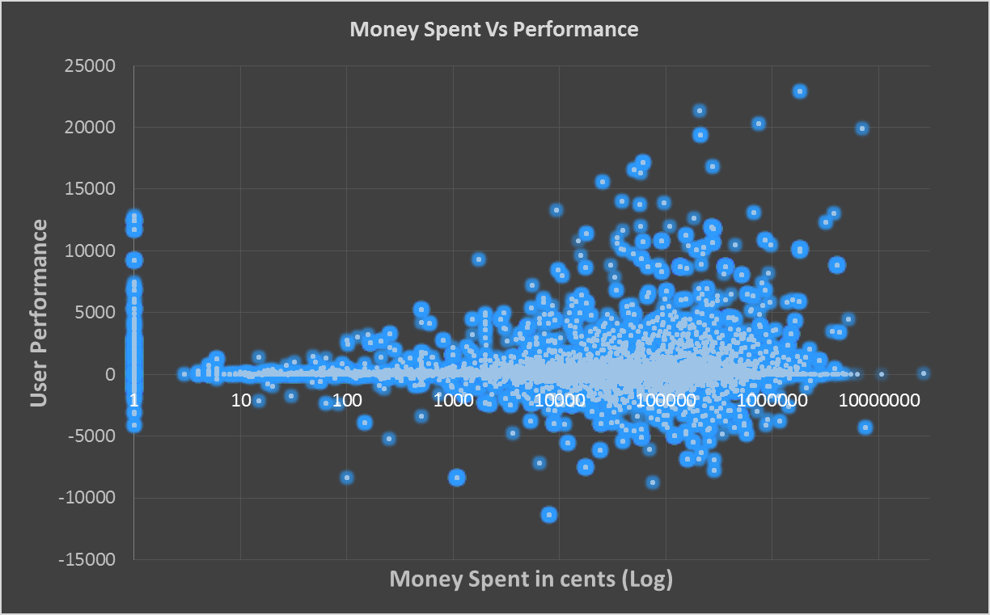
III. EXPENDITURE vs PERFORMANCE & SOCIAL INTERACTION
Correlation Coefficient
0.11859842
Kolgomorov-Smirnoff Test
P value<2.2e-16
Null hypo: both are from same distribution. Alternate hypo cant be rejected.
Mutual Information
3.72616
RESULT
Weak relationship between Expenditure and Performance of the User
Notes:
Left side shows all the users who don’t spend money at all.
Right side you have the data distributed showing the variation in the data given the amount of money spent. We see slight increasing trend in the performance along with amount of money spent on gaming.
MI shows positive share of info. Corr is low.
KS test is negative.

Slide 27
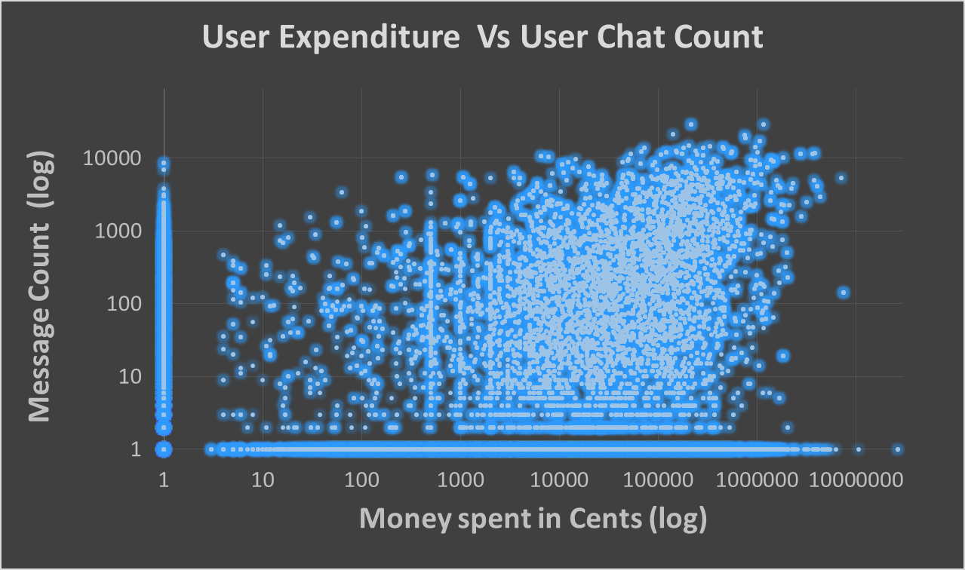
III. EXPENDITURE vs PERFORMANCE & SOCIAL INTERACTION
0.233673337
Correlation Coefficient
0.23367334
Kolgomorov-Smirnoff Test
P value<2.2e-16
Null hypo: both are from same distribution. Alternate hypo cant be rejected.
Mutual Information
0.88868
RESULT
Weak relationship between the Expenditure and the Social interaction of the User.
Notes:
The amount of message count and the user expenditure. People who hasn’t spent money and not chatted at all along the lines. And there is small bunch here who do spend and talk . Those who spends more tends to talk more in the slightest manner in a very weak relationship. Inconclusive ks test but positive correlation ,and very less info share via mutual info.

Slide 28
IV. Text PROCESSING OF ALLIANCE CHATS
AIM: Text processing of Alliance chats.
PURPOSE:
Understanding User’s messages gives essence of their game play strategies, idea, goals.
It gives us their impressions on the game, on the alliances, on each other.
We can see the sentiments of the User, Alliances and understand who likes and is happy about the games and who would is not happy.
We can classify the Users geographically based on the language of communication.
We can correlate the actions taken by the User to the communication they had.
We can understand the Organization of the Alliances and their activities.
We can recommend happy teams/alliances for an unhappy Users.
We can understand the subjectivity of their language. This is useful to understand their personality. People who are more objective vs people who are more subjective.
Notes:
Understand users impressions, goals, likes, dislikes, happiness, sadness, the mood, excitement, boredom,
Difference between organization of users. How much actions are coordinated vs uncoordinated actions.

Slide 29
IV. Text PROCESSING OF ALLIANCE CHATS
LINGO
Users tend to use short form English words called as Lingo.
“peopl clse 2 my hart alw get D 1st msg 4 D dy.. gud mornin “ which means “People close to my heart always get the first message for the day. Good Morning”
Words from http://transl8it.com/largest-best-top-text-message-list/
CAPTURING EMOTICONS
Shorter symbols express more meaning and context.
The messages are selectively parsed for the emoticons such as : -)
The Challenge: Lingo and emoticons evolve over time. Symbol “ ~:\ “ . This means an Elvis
DETECT LANGUAGE
Use Chromium compact language detector from Google package for python.
Gramar issues- “where too?” “stupid keyboard“ “how you been”
Gibberish - “yourrrrrrr greaaaaaaatt”
Parts of Speech Tagging.
Using TextBlob Package in python.
Notes:
The Given Data for this Data Science study: 1. Attacks data. 2. Alliance Chat. 3. User Data.

Slide 30
IV. Text PROCESSING OF ALLIANCE CHATS
Grammar issues- “where too?” “how you been”
Notes:
The Given Data for this Data Science study: 1. Attacks data. 2. Alliance Chat. 3. User Data.

Slide 31
IV. Text PROCESSING OF ALLIANCE CHATS
Gibberish - “yourrrrrrr greaaaaaaatt”
Notes:
The Given Data for this Data Science study: 1. Attacks data. 2. Alliance Chat. 3. User Data.

Slide 32
IV. Text PROCESSING OF ALLIANCE CHATS
SENTIMENT ANALYSIS
A basic task in sentiment analysis is classifying the polarity of a given text at the document, sentence, or feature/aspect level.
Polarity is a real value between +1(positive) ,0(neutral) & -1(negative).
TextBlob package in Python.
Uses a Native Bayes Classifier for Sentiments.
SUBJECTIVITY ANALYSIS
The linguistic expression of somebody’s opinions, sentiments, emotions, evaluations, beliefs, speculations (private states which are personal to themselves).
The following "I love my food" has a positive subjectivity while. “sunny weather" has zero subjectivity.
TextBlob package in python.
Notes:
The Given Data for this Data Science study: 1. Attacks data. 2. Alliance Chat. 3. User Data.

Slide 33
IV.TEXT PROCESSING ALLIANCE CHATS
$User delight = abslog(sum of User Sentiment ∗ sum of subjectivity∗ count of comments$)
Abslog finds –log $\left\|num\right\|$for -ve numbers; Log (num+1) for others.
Happiest Users
UserID | Sentiment | subjectivity | count | Delight
1493831 | 2508.977 | 10743.93 | 29136 | 11.895
578124 | 2148.754 | 7827.686 | 21083 | 11.549
3765281 | 2309.957 | 6930.6 | 20577 | 11.517
2. Happiest Alliances
AllianceID | sum(SI.sentiment) | sum(SI.subjectivity) | count | Delight
21114|2 | 9831.675 | 58812.22 | 169784 | 13.991
22587|21 | 10858.63 | 39995.48 | 136743 | 13.773
8647|2 | 9369.567 | 39571.57 | 144412 | 13.728
Notes:
The Given Data for this Data Science study: 1. Attacks data. 2. Alliance Chat. 3. User Data.

Slide 34
IV.TEXT PROCESSING ALLIANCE CHATS
$$Feel Good =Win−Lost+abslog( Sentiment+ sum of subjectivity+ count of comments)$$
Happiest Users (Feel Good)
User id | Subjectivity | Sentiment | Count | Win Count | Lost Count | FEEL GOOD
100218 | 202.3972 | 46.14497 | 755 | 17688 | 151 | 17540.69
3765281 | 5627.079 | 2071.066 | 21567 | 12027 | 257 | 11775.16
1888783 | 266.7217 | 117.4101 | 981 | 8069 | 202 | 7870.94
2. Disappointed Users (Feel Good)
User id | Subjectivity | Sentiment | Count | Win Count | Lost Count | FEEL GOOD
8648066 | 144.0611 | 42.18857 | 1211 | 19 | 574 | -551.16
2773733 | 27.03306 | 8.68584 | 194 | 378 | 760 | -378.94
1098040 | 401.2151 | 88.81813 | 1495 | 40 | 324 | -280.00
Notes:
The Given Data for this Data Science study: 1. Attacks data. 2. Alliance Chat. 3. User Data.

Slide 35
V.USERS CHOICES ON ALLIANCE,KNIGHTs and GEO POLITICS
AIM: We want to understand the How users make their choices in the Alliances, Knights and Organized politics .
PURPOSE:
Understanding User’s choices on Alliances, gives us their user behavior on what they prefer to do.
It helps understand their strategies and customization to prepare for the war.
We can get to know them better and helps us understand their decision criteria.
We can take advantage using their behavior and apply predictive analytics.
Observing the level of partnerships between the Alliances helps us to create partner alert system which could alert trouble /victory for the partner alliances.
We can recommend Knights for the Troops based on the Knights past performance.
We can advise the Alliance to be more cohesive rather than adhesive or vice versa.
We could recommend new Friends/partners to a common enemy.
Notes:
The Given Data for this Data Science study: 1. Attacks data. 2. Alliance Chat. 3. User Data.

Slide 36
V.USERS CHOICES ON ALLIANCE,KNIGHTs and GEO POLITICS
Number of Alliance associated | None | One | Two | >2
Percentage of Users | 66% | 28% | 4% | 0.5%
Notes:
The Given Data for this Data Science study: 1. Attacks data. 2. Alliance Chat. 3. User Data.

Slide 37
V.USERS CHOICES ON ALLIANCE,KNIGHTs and GEO POLITICS
Number of Alliances supported | One | Two | Three | > Three
Percentage of Knights | 69.44% | 21% | 6% | 3.56%
Notes:
The Given Data for this Data Science study: 1. Attacks data. 2. Alliance Chat. 3. User Data.

Slide 38
V.USERS CHOICES ON ALLIANCE,KNIGHTs and GEO POLITICS
Number of Knights Equipped | One | Two | Three | > Three
Percentage of Alliances | 69.44% | 21% | 6% | 3.56%
Notes:
This is the number of knights used by the alliances for their battles. The maximum is almost 5000 different knights.

Slide 39
V.USERS CHOICES ON ALLIANCE,KNIGHTs and GEO POLITICS
INSIGHTS ON RIVALRY:
No fights amongst the members of the same alliance.
Users and Alliances have their rival and archenemies with whom they keep fighting again and again.
Match Marathons: Relentless fighting on a single day till their moms shout at them.
We should celebrate the valor of these fighters with Rival leaderboards and trophies.
No | S0UserID | S1UserID | Match Count
1 | 25112 | 2486380 | 19256
2 | 21536 | 6745138 | 2691
3 | 9114900 | 1508200 | 2114
No | S0AllianceID | S1AllianceID | Match count
1 | 336|1 | 20118|1 | 20230
2 | 8647|2 | 21114|2 | 5103
3 | 336|1 | 516|1 | 4558
No | S0Userid | S1UserID | Date | Match Count
1 | 25112 | 2486380 | 10/26/2013 | 19152
2 | 7452322 | 1458478 | 11/1/2013 | 785
3 | 5573073 | 7384945 | 11/15/2013 | 658
No | S0Alliance | S1Alliance | Date | Match Count
1 | 336|1 | 20118|1 | 10/26/2013 | 19160
2 | 19527|21 | 15805|21 | 12/15/2013 | 752
3 | 22211|21 | 23227|21 | 11/15/2013 | 702
Notes:
Rivalry is the core of competition in any competition. Gaming ,it is highly pronounced. We find the top contentious people.
We also find the marathon warriors who keeps on fighting on day till their shout at them for doing so.

Slide 40
V.USERS CHOICES ON ALLIANCE,KNIGHTs and GEO POLITICS
OBSERVATIONS ON KNIGHTS:
Presence or Absence of Knights:
Is a knight necessary?
Internal or External Knights:
how the users prefer a Knight from the same alliance to a Knight from a different alliance.
Categories | Match Side | Matches with No Knights | Matches with Knights | % of Matches with No Knights | % of Matches with Knights
Total Matches | Defending | 2929282 | 123014 | 96% | 4%
 | Attacking | 21 | 3052275 | 99.99% | 0.00%
Categories | Match Side | Matches with Same Alliance Knight | Matches with External Alliance Knight | % of Matches with Internal Knight | % of Matches with External Knight
Total Matches | Defending | 119341 | 3673 | 97.01% | 2.98%
 | Attacking | 3047421 | 4854 | 99.84% | 0.15%
Notes:
Among the knights chosen by the alliances in their battles 99% of the attacking side choses to have a knight while 96% chose to have knights.
Among the knights for either side 97% of the defense side knights are from within the alliance. And 3% outside the alliance.
While the attacking choses their knights from within their own alliance.

Slide 41

V.USERS CHOICES ON ALLIANCE,KNIGHTs and GEO POLITICS
GEO POLITICS ON ALLIANCES:
Sharing of Knights: Friendship. The more the knights shared the lesser the distance between them.
For alliance A and alliance B,
Distance(A,B)= $\frac{1}{1+Number of knights shared between A \& B}$
Categories | Match Side | Clustering Method | Number of clusters
Alliance | Defending | K means | 12
 | Attacking | K means | 9
Notes:
Among the knights chosen by the alliances in their battles 99% of the attacking side choses to have a knight while 96% chose to have knights.
Among the knights for either side 97% of the defense side knights are from within the alliance. And 3% outside the alliance.
While the attacking choses their knights from within their own alliance.

Slide 42
V. LOCATION Vs Performance
AIM:
To study the impact of the Location in the performance of Users.
PURPOSE:
The Location in the Game of Kingdom of Camelot is chosen by the gamers to build their city
Location choice is strategically made. It needs to be in a suitable position favorable for both attack and defense.
It should have the right set of neighbors friends or enemies.
We can perhaps suggest a suitable location for future gamers via recommendation.
Metrics Used Location & Performance Scores
1.Correlation Coefficient .
2.Mutual Information.
3.Kolmogorov Test of similarity in the distributions.
Notes:
Location vs performance. Does the vicinity or the neightbors or the enemies matter?? Does the location matter for the performances?
We use three measures mentioned before to identified them all.

Slide 43
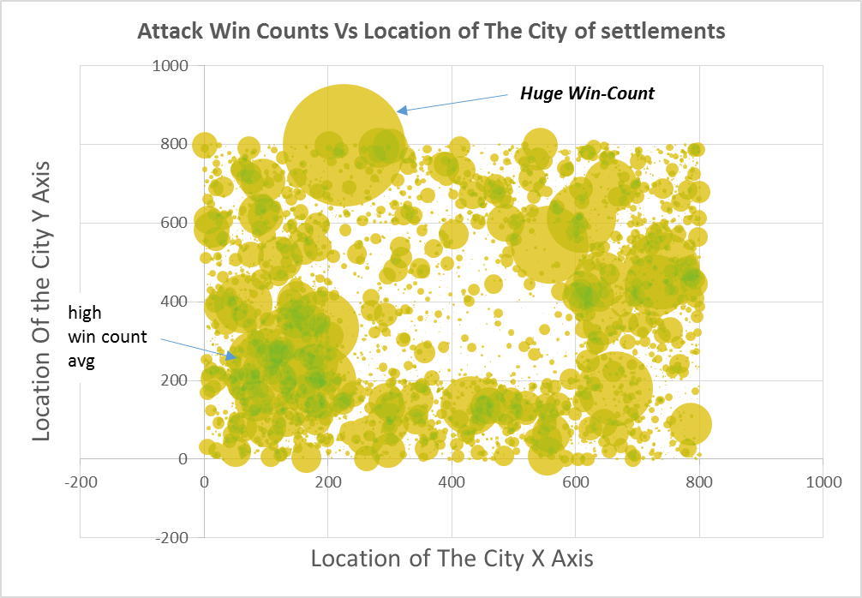
V. LOCATION Vs Performance –Win Counts
Correlation Coefficient
-0.00053
Kolgomorov-Smirnoff Test
D=0.9985
P value<2.2e-16
Null hypo: both are from same distribution. Alternate hypo cant be rejected.
Mutual Information
0.959954
RESULT
Weak relationship between Win count and Location of the User
Average | Stddev | Max | Min
7.773 | 72.788 | 6747 | 0
Notes:
The Given Data for this Data Science study: 1. Attacks data. 2. Alliance Chat. 3. User Data.

Slide 44
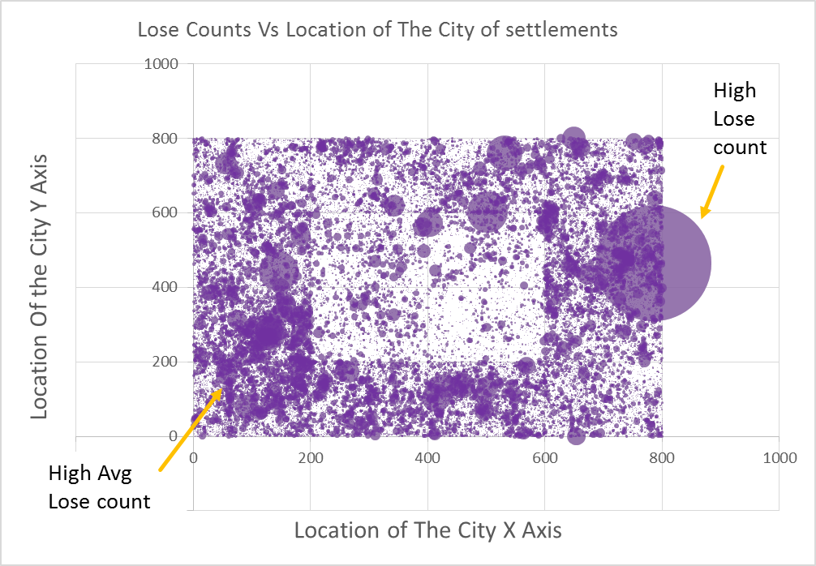
V. LOCATION Vs Performance-LOSE COUNTS
Correlation Coefficient
0.00884
Kolgomorov-Smirnoff Test
D=1
P value<2.2e-16
Null hypo: both are from same distribution. Alternate hypo cant be rejected.
Mutual Information
2.934839
RESULT
Weak relationship between Lose count and Location of the User
Average | Stddev | Max | Min
7.773 | 14.449 | 1588 | 0
Notes:
The Given Data for this Data Science study: 1. Attacks data. 2. Alliance Chat. 3. User Data.

Slide 45
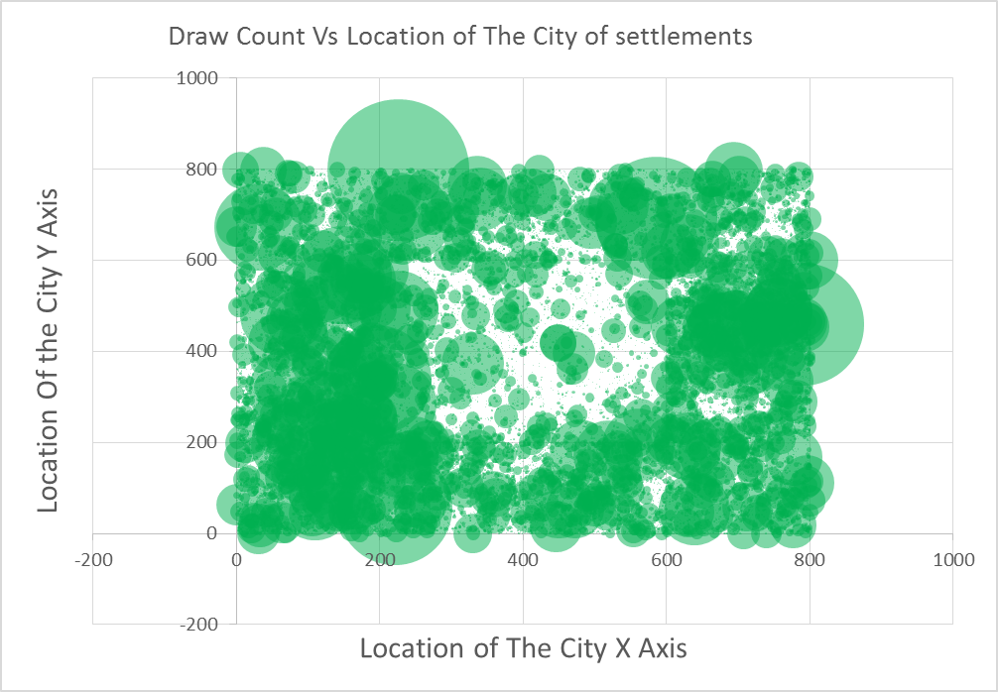
V. LOCATION Vs Performance
Correlation Coefficient
0. 01043
Kolgomorov-Smirnoff Test
D=0.9977
P value<2.2e-16
Null hypo: both are from same distribution. Alternate hypo cant be rejected.
Mutual Information
3.16612
RESULT
Weak relationship between Draw Count and Location of the User
Average | Stddev | Max | Min
19.922 | 92.928 | 5537 | 0
Notes:
The Given Data for this Data Science study: 1. Attacks data. 2. Alliance Chat. 3. User Data.

Slide 46
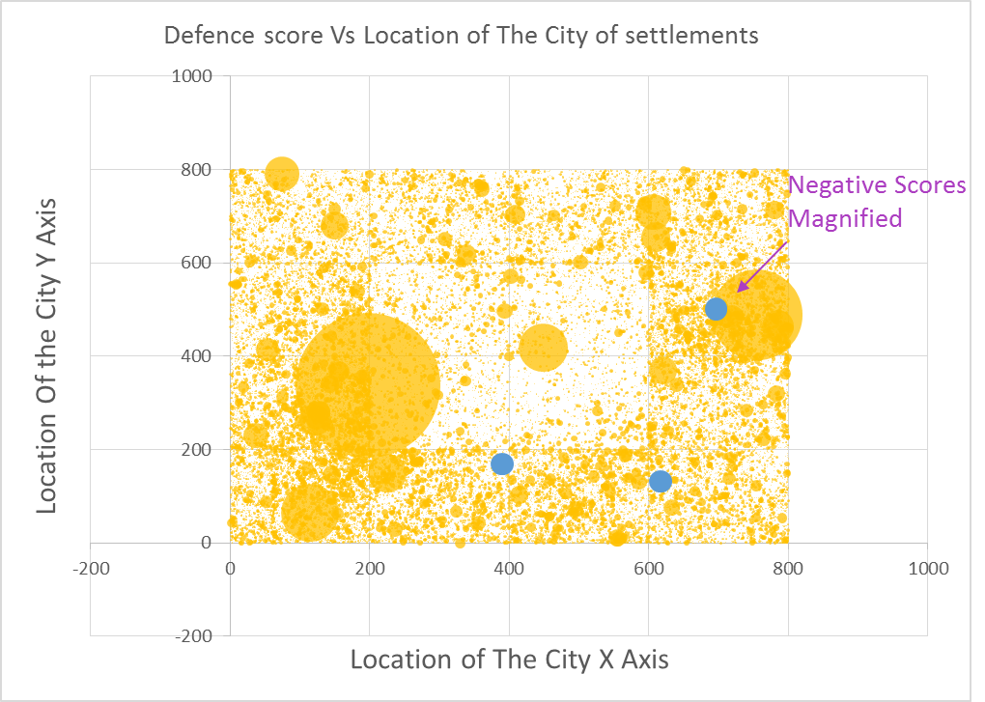
V. LOCATION Vs Performance
Correlation Coefficient
0.012533
Kolgomorov-Smirnoff Test
D=0.9999
P value<2.2e-16
Null hypo: both are from same distribution. Alternate hypo cant be rejected.
Mutual Information
3. 686872
RESULT
Weak relationship between Defense Score and Location of the User
Average | Stddev | Max | Min
20.658 | 42.603 | 5912.72 | -2.137
Notes:
The Given Data for this Data Science study: 1. Attacks data. 2. Alliance Chat. 3. User Data.

Slide 47
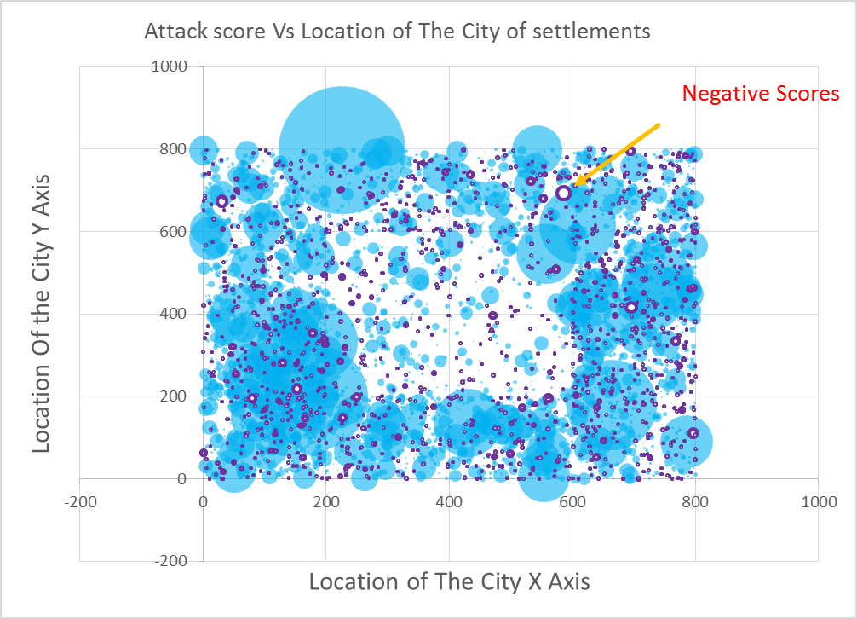
V. LOCATION Vs Performance
Correlation Coefficient
0.00131
Kolgomorov-Smirnoff Test
D=0.9982
P value<2.2e-16
Null hypo: both are from same distribution. Alternate hypo cant be rejected.
Mutual Information
0.937399
RESULT
Weak relationship between Losecount and Location of the User
Average | Stddev | Max | Min
7.859 | 84.032 | 8133.341 | -804.015
Notes:
The Given Data for this Data Science study: 1. Attacks data. 2. Alliance Chat. 3. User Data.

Slide 48
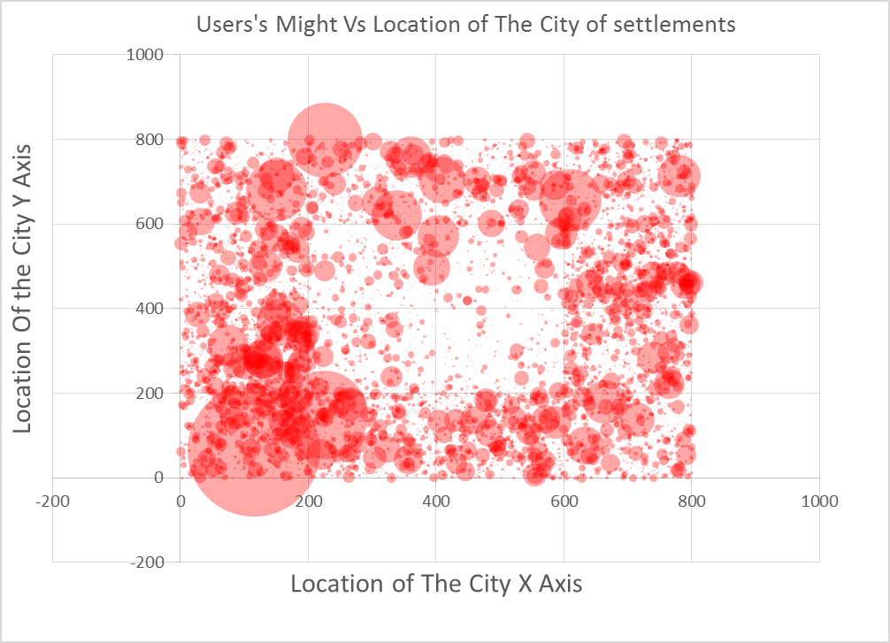
V. LOCATION Vs Performance
Correlation Coefficient
0.00884
Kolgomorov-Smirnoff Test
D=1
P value<2.2e-16
Null hypo: both are from same distribution. Alternate hypo cant be rejected.
Mutual Information
2.934839
RESULT
Weak relationship between Losecount and Location of the User
Average | Stddev | Max | Min
30.066 | 139.732 | 15145.08 | 0.693
Notes:
The Given Data for this Data Science study: 1. Attacks data. 2. Alliance Chat. 3. User Data.

Slide 49
VII. FUTURE IDEAS
The Pathway of the warrior. How does the gamer starts from the beginning to become a leader board winner. What are the strength of the opponents he faces, the might he gathers, the loot he collects, the troops he gather, win-lost curve.
Cluster the Users based on their pathway to becoming a Winner vs Otherwise.
Establish Winning Secret.
Relationship between mood and Performance. When Good/Bad warriors fight with Good /Bad Mood.
Which is best way to spend your might? How to form the best combination of troop for the fight.
Is might the only winner of war?
Relationship between Language spoken by the User Vs Performance.
Predict might results.
Predict loss of might /resources in a fight even before fighting??
Predict change of alliances for a User.
Notes:
The Given Data for this Data Science study: 1. Attacks data. 2. Alliance Chat. 3. User Data.

Slide 50
VII. FUTURE IDEAS
Summarize the communications in the messages to understand the crux. Build word cloud to see the top most discussed words/features of the game/qualities of the game/impression (both positive and negative) of the User on the Game.
Positive impact of external competitions/new special rounds/challenge rounds on the User’s Performance.
Establish Performance improvement methodologies. Evaluate their Effectiveness.
How does the happiness/Delight of the Users varies with expenditure of money, Improvement of Scores; Winning matches.
Introduce more rivalries between string fighters .. Like You have a new challenge!
Notes:
The Given Data for this Data Science study: 1. Attacks data. 2. Alliance Chat. 3. User Data.

Slide 51
V.USERS CHOICES ON ALLIANCE,KNIGHTs and GEO POLITICS
Notes:
The Given Data for this Data Science study: 1. Attacks data. 2. Alliance Chat. 3. User Data.

Slide 52
III. User EXPENDITURE vs PERFORMANCE & INTERACTION
AIM
WHAT NEXT?
Does expenditure improve performance?
what are potential matches for today?
More Info on Score computation.?
Add distribution of Happiness.
Notes:
The Given Data for this Data Science study: 1. Attacks data. 2. Alliance Chat. 3. User Data.

